Slide 1
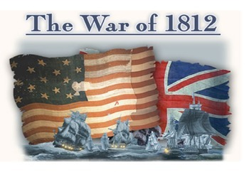
PRELUDE TO WAR

Slide 2
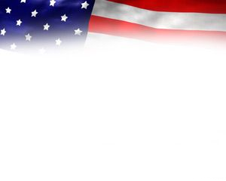
PRELUDE TO WAR
Britain and France were at war in the 1800’s
Thanks to Napoleon
Britain created the Orders of Council to stop neutral countries from trading with France in 1807.
Britain was capturing American ships and forcing the sailors to serve for Britain.
This was called Impressment.
Protection Papers would be issued to sailors to prove citizenship if they were captured.

Slide 3
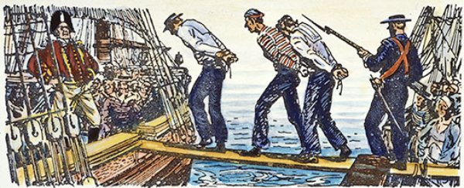
PRELUDE TO WAR

Slide 4
PRELUDE TO WAR
In 1807, the Embargo Act was created to prevent U.S. ships from foreign trade.
The Embargo Act was a disaster that hurt the U.S. as much as it did Europe.
It was repealed in 1809 and replaced by the Non-Intercourse Act, which let the U.S. trade after war ended.
This was also replaced in 1810.

Slide 5
PRELUDE TO WAR
Members of congress wanted to retaliate against Britain.
Known as War Hawks.
Henry Clay was a senator from Kentucky.
John C. Calhoun was a House Congressman from South Carolina.

Slide 6
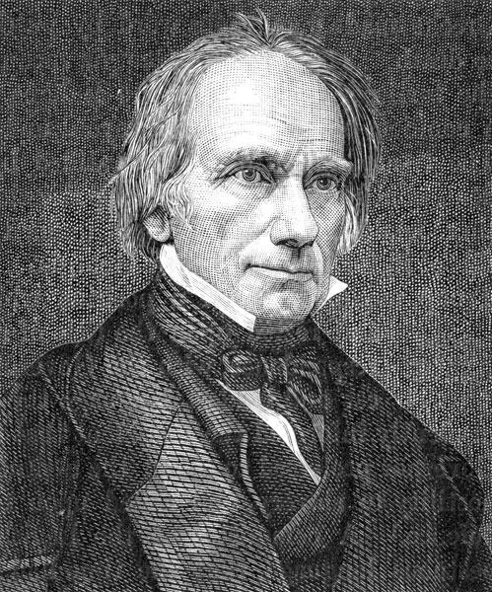
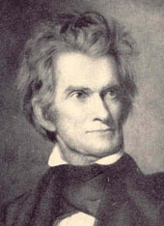
PRELUDE TO WAR

Slide 7
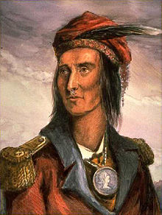
PRELUDE TO WAR
Tecumseh
Native from the Shawee tribe tried to unite the tribes with the aid of the British.
Tried to stop the westward expansion of white settlers.
White settlers were occasionally attacked by the natives .

Slide 8
PRELUDE TO WAR
Battle of Tippecanoe (Nov. 7th,1811)
The Governor of the Indiana Territory William Henry Harrison led a 1,100 man force to the native’s village where they gathered.
Harrison’s forces were ambushed, but still defeated the natives and drove them out of the area.

Slide 9
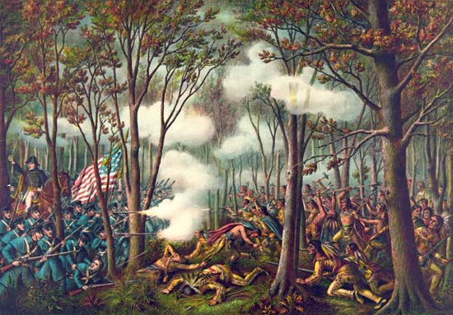
PRELUDE TO WAR

Slide 10
PRELUDE TO WAR
Arming the Natives
Britain and Canada had been arming Native Americans to fight against the U.S.
With a potential war at hand, many considered the Annexation of Canada, which would add it to the U.S.
This was seen as a potential as a bargaining chip to be used against Britain.

Slide 11
PRELUDE TO WAR
Thomas Jefferson, President Madison, and the War Hawks all believed capturing Canada would be an easy task.
Madison sent a list of Grievances about Britain to Congress, and Congress agreed to go to war.
War is declared on June 18th, 1812.
It took almost two months for the Declaration of War to reach Britain.

Slide 12
War Begins
Fighting Canada
General William Hull led Americans..
General Isaac Brock led the British and Canadian forces.
Canada heard about the war before Britain did and prepared for the attack.
Because the US military had to rely on their inexperienced militia, many Americans fled battles

Slide 13
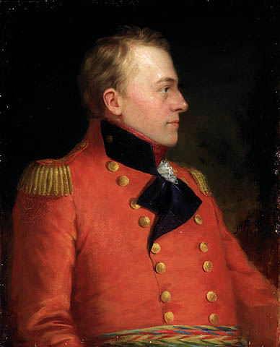
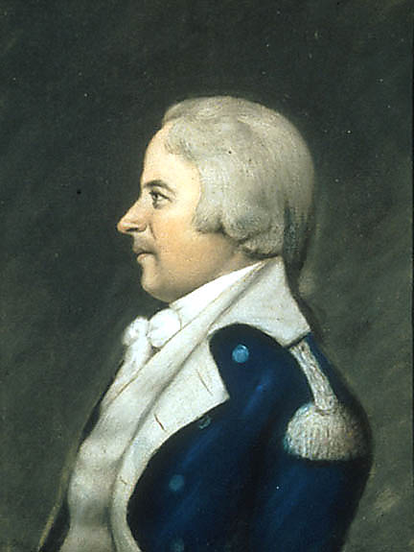
War Begins

Slide 14
The Battles
July 1812
Failed American invasion of Canada
Siege of Fort Mackinac (Michigan)
British victory
Battle of Sacket’s Harbor (New York)
August 1812
Siege of Fort Detroit (Michigan)
Americans surrender
October 1812
Battle of Queenston Heights (Ontario)
British victory

Slide 15
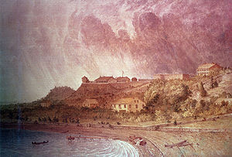
The Battles

Slide 16
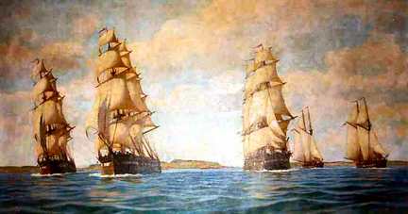
The Battles

Slide 17
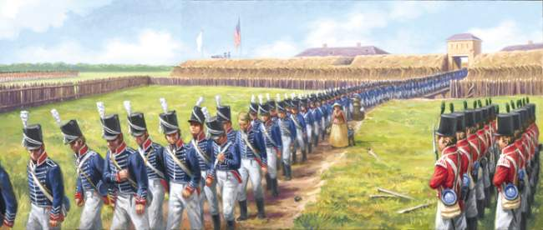
The Battles

Slide 18
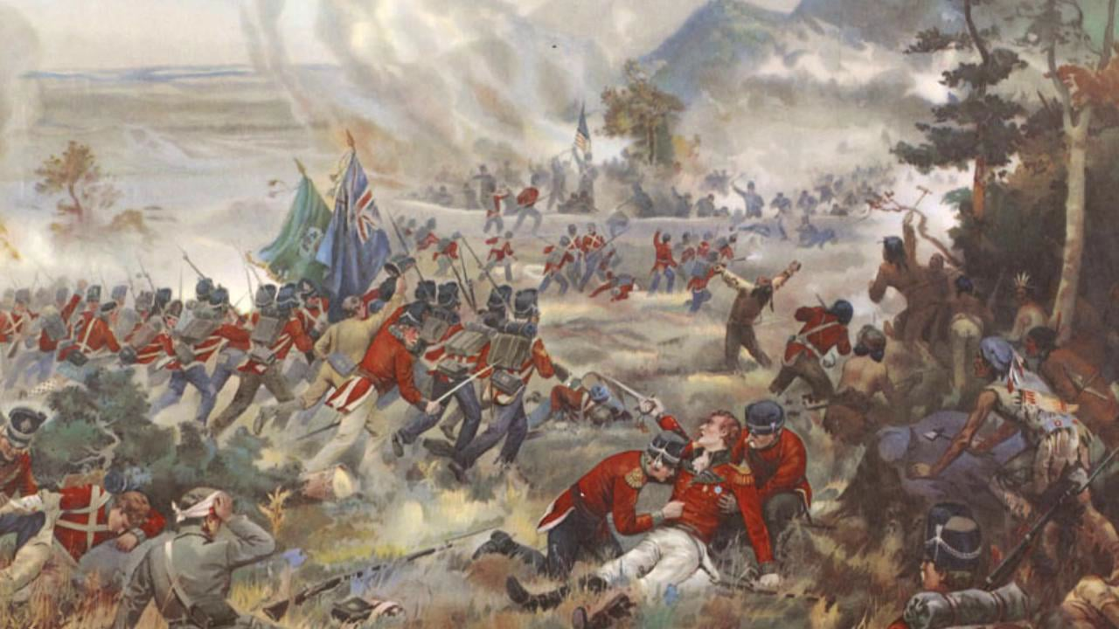
The Battles

Slide 19
The Battles
Since the Battle of Tippecanoe, the Native Americans were launching several attacks on U.S. outposts.
These happened in several places such as Illinois, Indiana, Ohio, etc.
More and more tribes began to take sides with the British during the war.

Slide 20
Reelection
During the time of the war, James Madison was running for re-election.
Dewitt Clinton was the governor of new York who ran against Madison.
Madison barely won the election and continued to lead the country during the war.

Slide 21
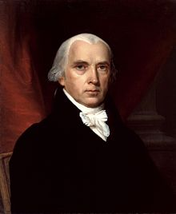
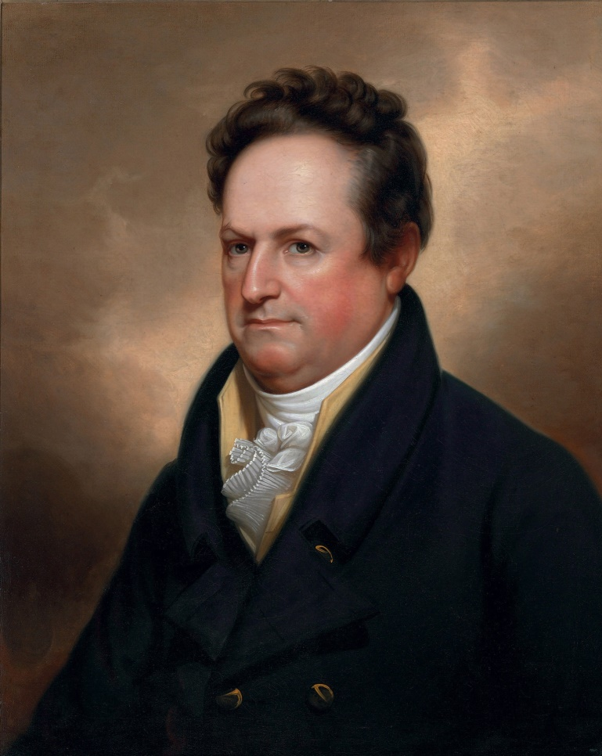
First Battles

Slide 22
War Continues
January 1813
Battle of Frenchtown (Michigan)
Highest number of causalities in the war
Americans vs Natives (Native victory)
February 1813
Battle of Odgensburg (New York)
British victory
April 1813
Battle of York (Toronto)
American Victory

Slide 23
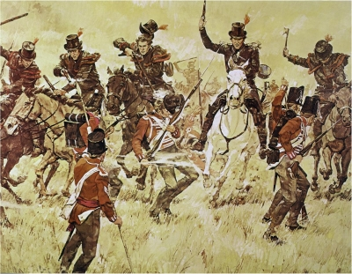
War Continues

Slide 24
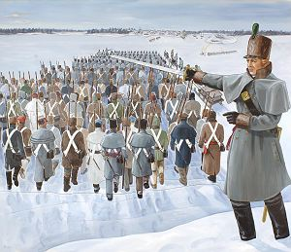
War Continues

Slide 25
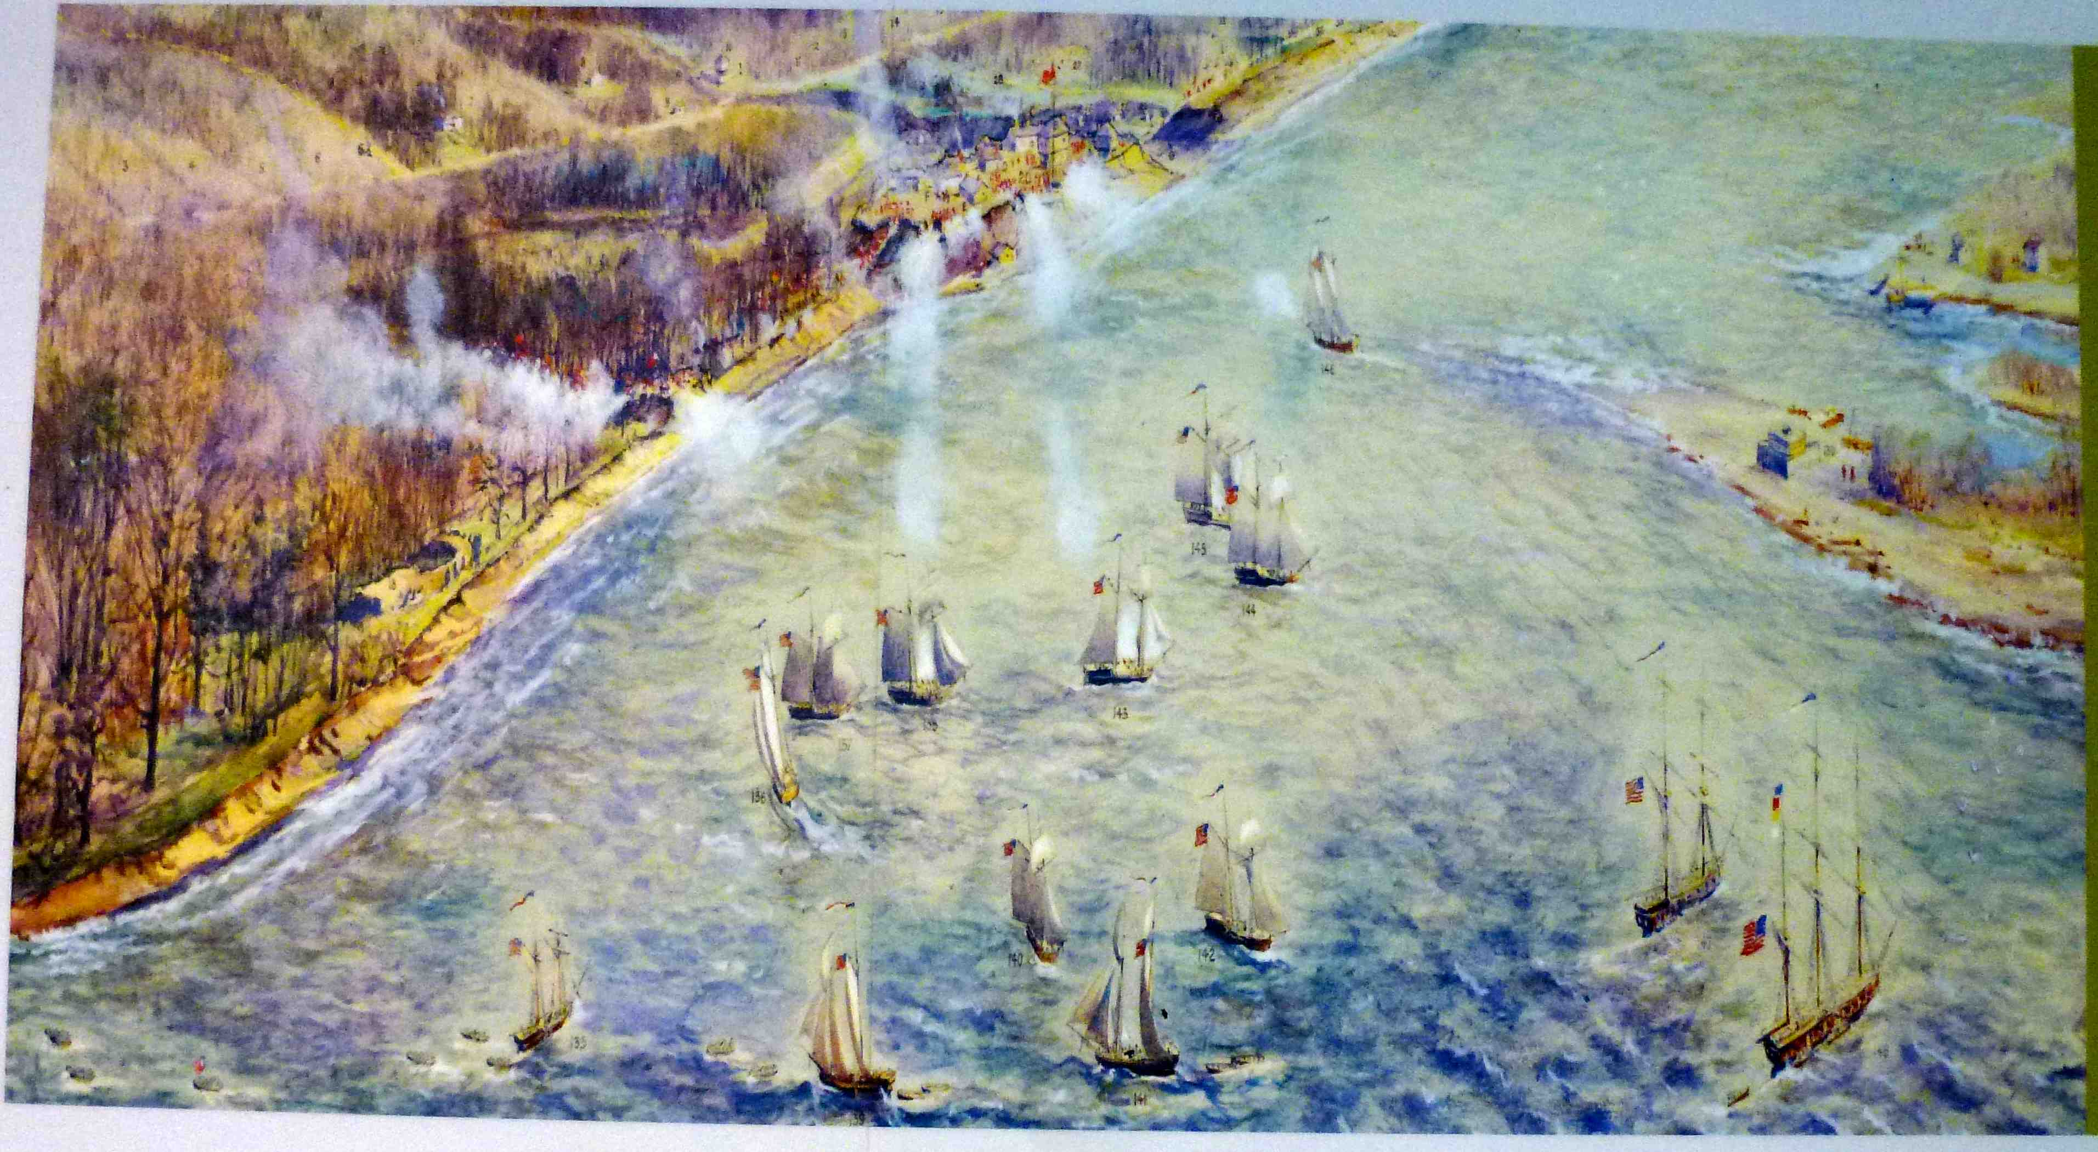
War Continues

Slide 26
War Continues
June 1813
Battle of Stony Creek (Ontario)
British Victory
September 1813
Battle of Lake Erie
American victory
Battle of Thames (Ontario)
American Victory

Slide 27
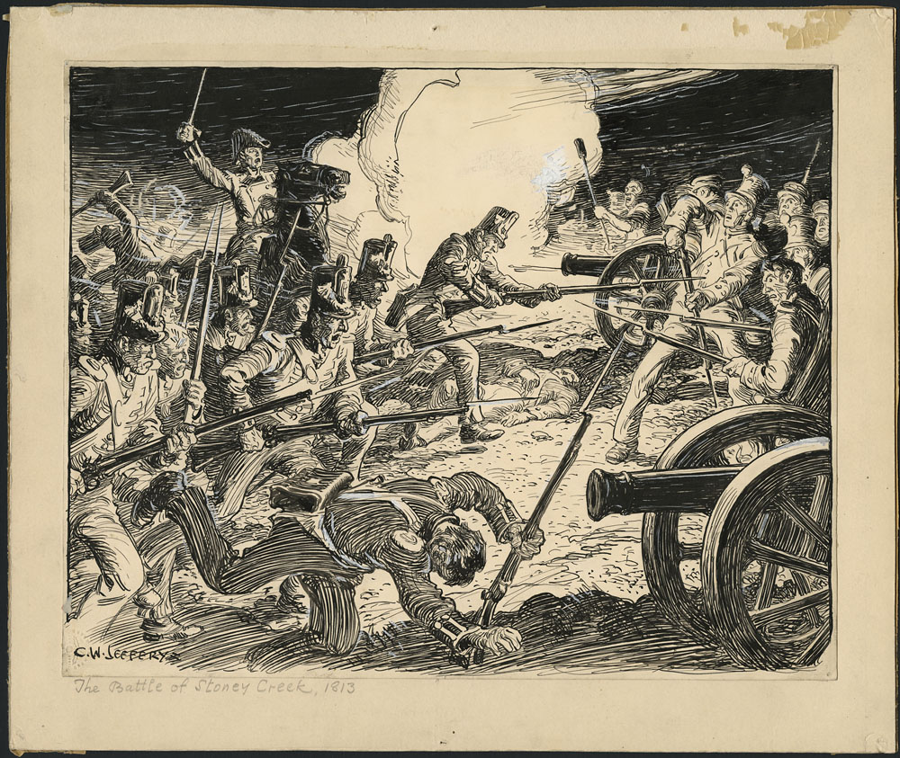
War Continues

Slide 28
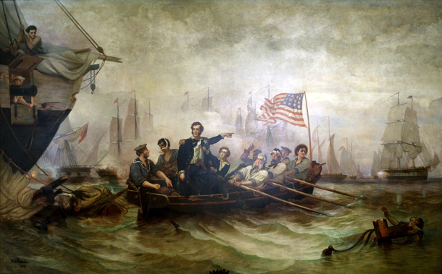
War Continues

Slide 29
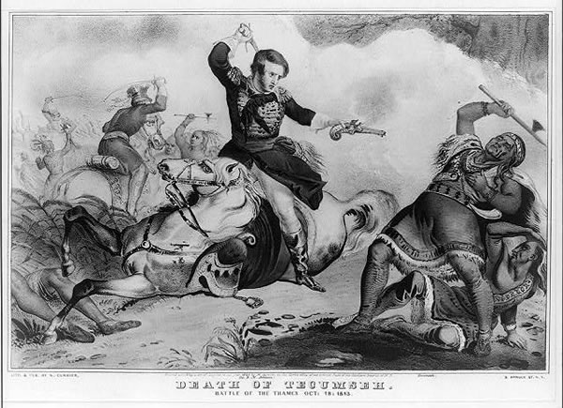
War Continues

Slide 30
The Creek
The Creek War
Occurred in the lower states.
Between the Red Stick Creek Tribe and the U.S.
The Cherokee, the Choctaw, and Lower Creek tribes aided the U.S.
The Creek tribe had ties to Tecumseh’s confederation and occurred at the same time as the War of 1812.
The war lasted from 1813 to 1814.

Slide 31
The Creek
The Creek War started with a small civil war among the tribe itself.
The Red Sticks (upper) Creeks began fighting with the White Stick (lower) Creeks.
The U.S. stepped in, which began the Creek War.
General Andrew Jackson led southern American soldiers to fight in this war.
At the end of the Creek War, the U.S. obtained land from Georgia, Alabama, and Mississippi.

Slide 32
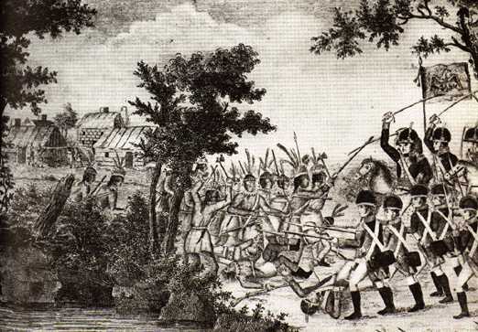
The Creek

Slide 33
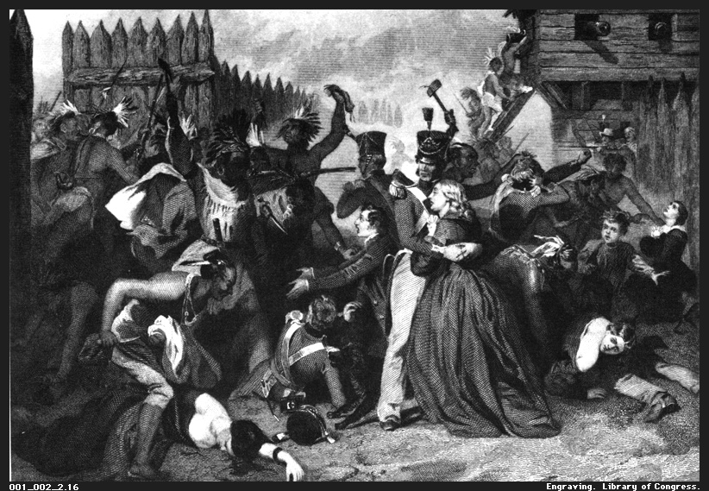
The Creek

Slide 34
War Continues
December 1813
Burning of Newark (Ontario)
American Victory
Battle of Buffalo (New York)
British Victory
July 1814
Battle of Landy’s Lane (New York)
Battle was a stalemate

Slide 35
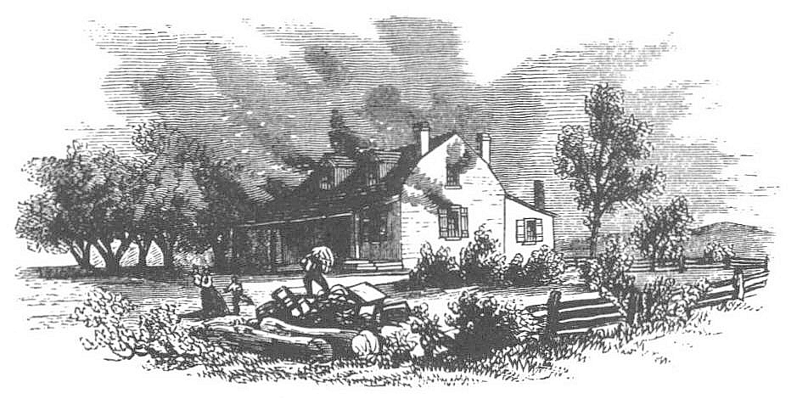
War Continues

Slide 36
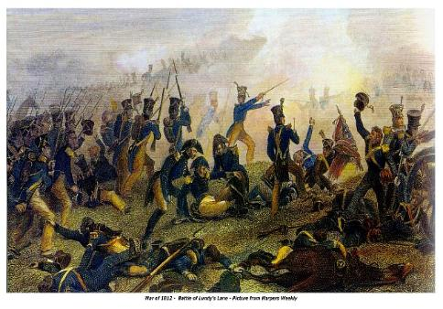
War Continues

Slide 37
War Continues
August 1814
Siege of Fort Erie (Ontario)
American Victory
Battle of Bladensburg (Maryland)
British Victory
Followed by the Burning of DC
British troops entered Washington DC and burned down the Whitehouse

Slide 38
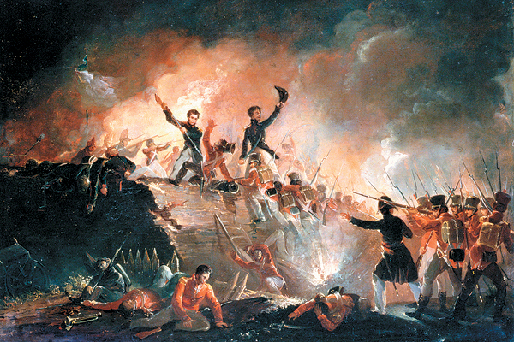
War Continues

Slide 39
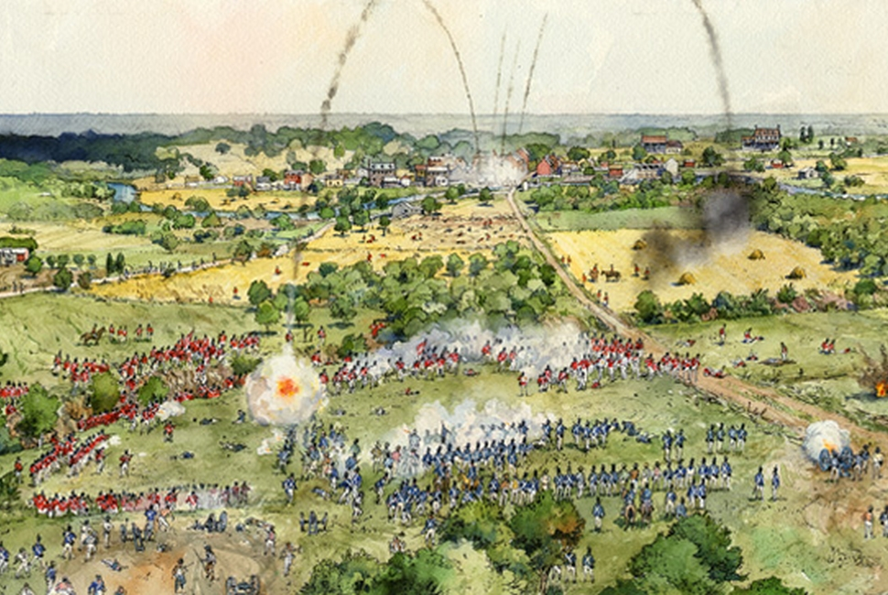
Coming to an End

Slide 40
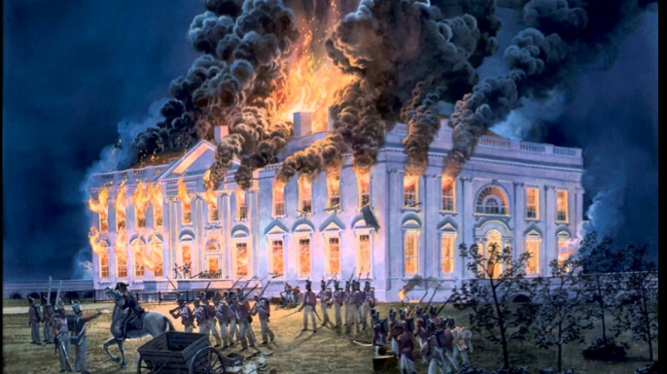
Coming to an End

Slide 41
War Continues
September 1814
Battle of Plattsburg (New York)
American Victory
Battle of Baltimore (Maryland)
American Victory
3,500 Americans fought off an invasion force of nearly 14,000 British and Canadians.
This was a major American victory and ended the northern invasion of the U.S.

Slide 42
Coming to an End
An American lawyer, Francis Scott Key, who was captured onboard a British ship.
Key watched the Battle of Baltimore onboard the ship, which inspired him to write the Star-Spangled Banner.
Key watched Fort McHenry fight off the invading forces and saw that the American flag still stood in the aftermath.

Slide 43
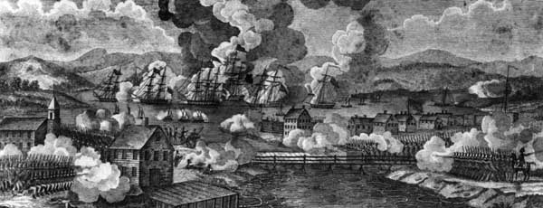
Coming to an End

Slide 44
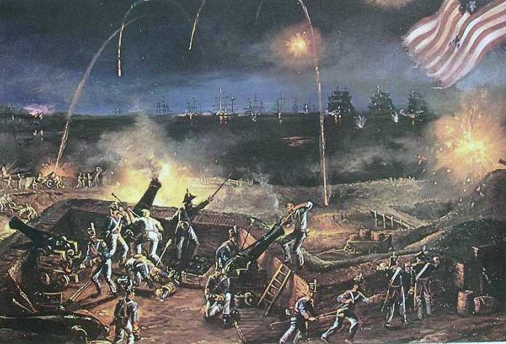
Coming to an End

Slide 45
Coming to an End
During 1814, ambassadors from Great Britain and the United states met in Ghent, Netherlands.
The U.S. was pushing to annex Canada.
The British wanted to create a supervised state for Native Americans from Ohio to Wisconsin to halt American expansion.

Slide 46
Coming to an End
The British also demanded control of the Great Lakes as well as parts of the Mississippi.
Both sides could not reach an agreement until December of 1812.
The Treaty of Ghent was signed on December 24th, 1814.
The treaty released all captured prisoners, ships, and property.
All land before the war was returned to the owners.

Slide 47
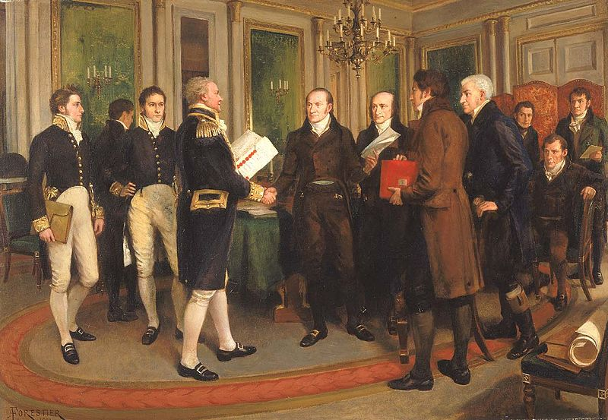
Coming to an End

Slide 48
Coming to an End
News of the treaty did not reach America right away.
While it was being signed, the British fleet was preparing to launch an attack on New Orleans.
On January 6th, the Battle of New Orleans begun.

Slide 49
Coming to an End
The British sent 14,500 troops with 60 ships to fight the defending force of 4,700 Americans and their 3 ships.
General Andrew Jackson led the Americans to victory against the British.
The British suffered almost ten times the casualties as the Americans.

Slide 50
Coming to an End

